Slide 1
Welcome to the Windows IoT World
Harold Pulcher
Improving Enterprises

Slide 2
Welcome to Houston TechFest
Thank you for being a part of the 9th Annual Houston TechFest!
Please turn off all electronic devices or set them to vibrate.
If you must take a phone call, please do so in the lobby so as not to disturb others.
Thanks to our Diamond Sponsors:

Slide 3
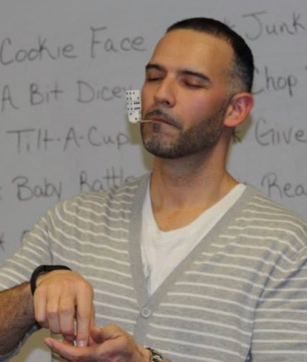
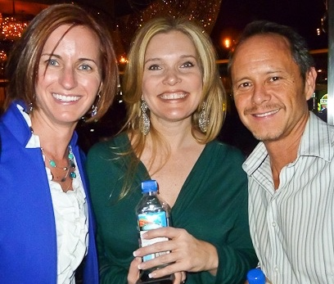
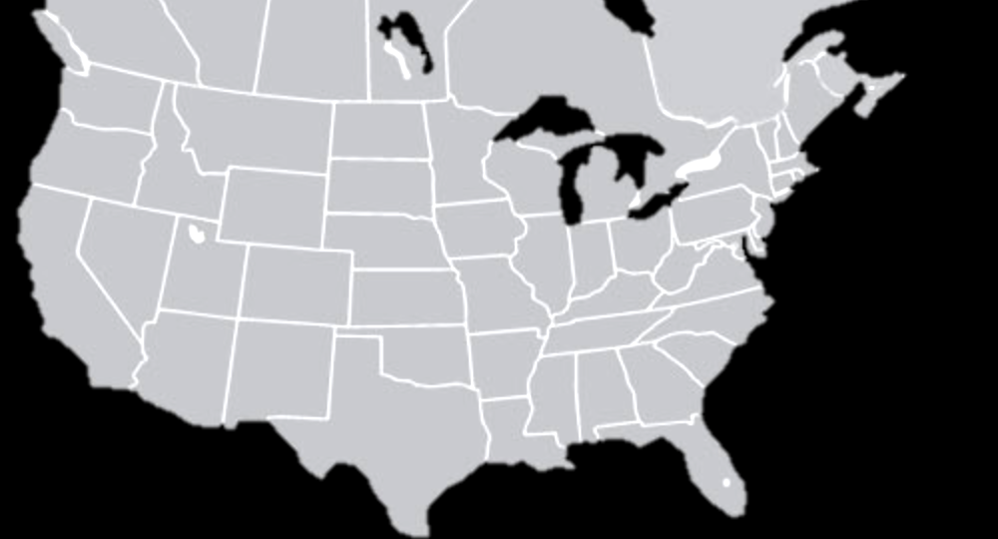
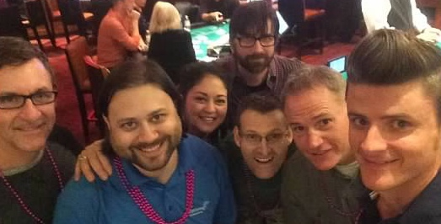
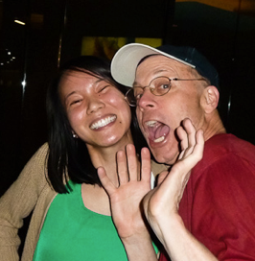
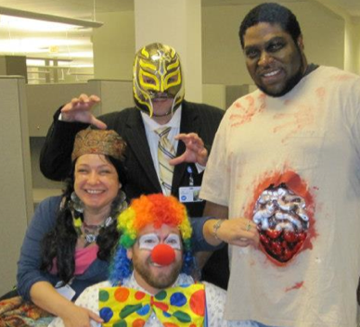
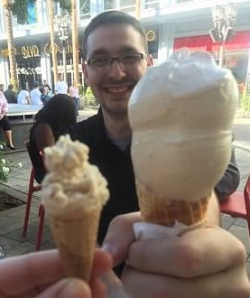
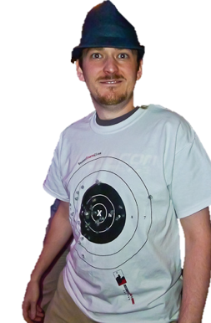
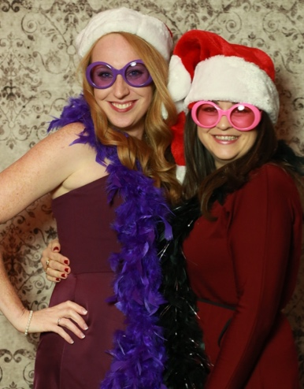
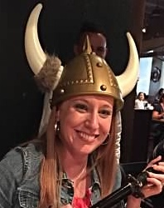
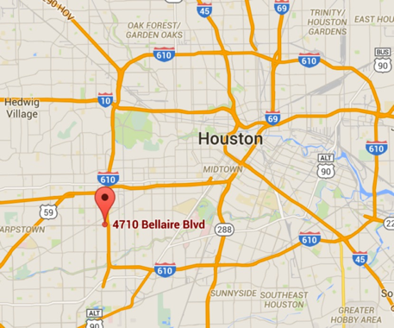
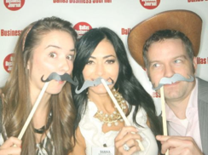
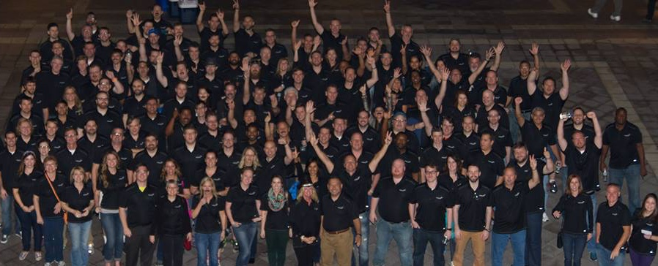
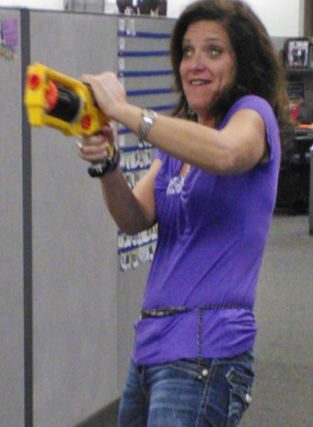
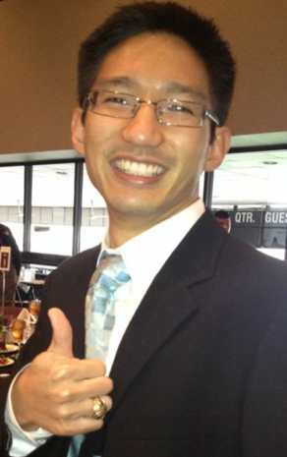
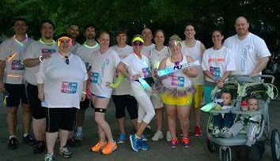
We are:
300+ Improvers
Software Developers
Agilists
Industry Thought Leaders
Education Providers
Centrally located
Four large classrooms
Client project room(s)

Slide 4
Welcome to the Windows IoT world
Harold Pulcher
pulcher@pulcher.biz

Slide 5
Internet of Things
20 billion devices
Metcalf’s Law
Development is easy
Hardware is cheap

Slide 6
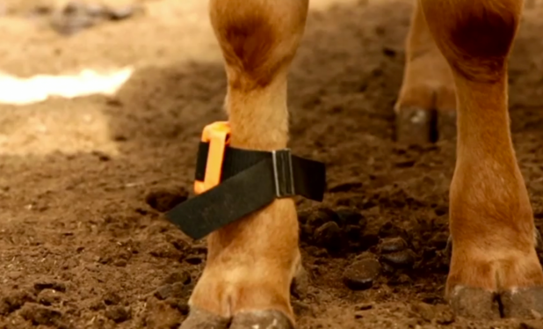
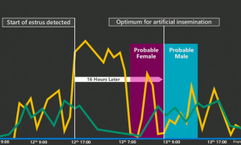
Connected Cow

Slide 7
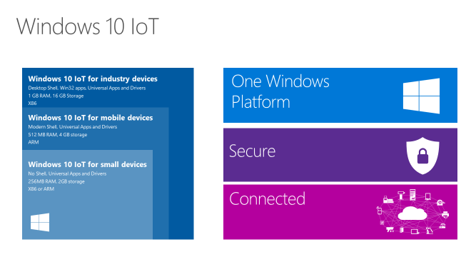
Window 10 IoT core

Slide 8
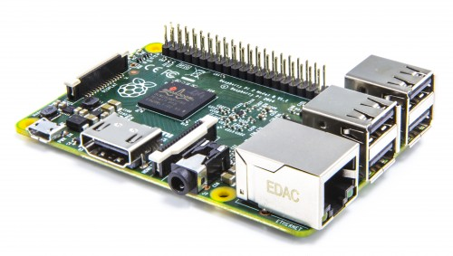
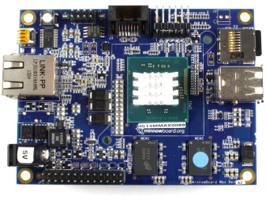
Devices
Raspberry Pi 2
http://www.raspberrypi.org
MinnowBoard Max
http://www.minnowboard.org

Slide 9
All of this stuff is on the edge. It is not ready for production. Don’t go building life sustaining gadgets with stuff (yet)!

Slide 10
What do you need?
Windows 10
Visual Studio 2015
http://ms-iot.github.io/content/en-US/GetStarted.htm
Raspberry Pi 2
5V micro USB power supply
8GB(min) class 10 micro SD card <- spend money on a good one!
HDMI cable
Enternet Cable
USB Mouse and Keyboard

Slide 11
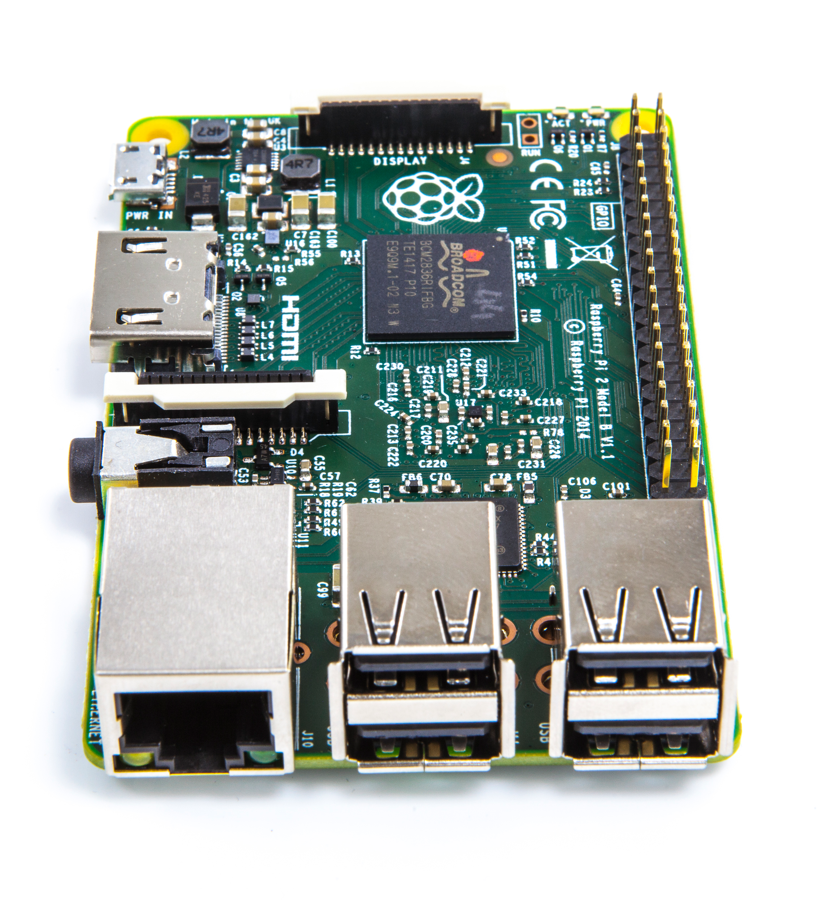
Raspberry Pi 2
900 MHz Quad Core ArmV7 processor
1GB Ram
4 USB ports
HDMI
GPU
GPIO
SPI
Ethernet

Slide 12
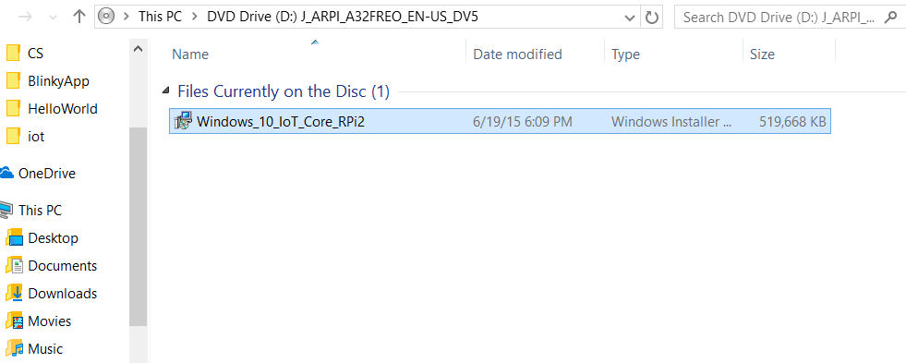
Enough already! How do I do this!

Slide 13
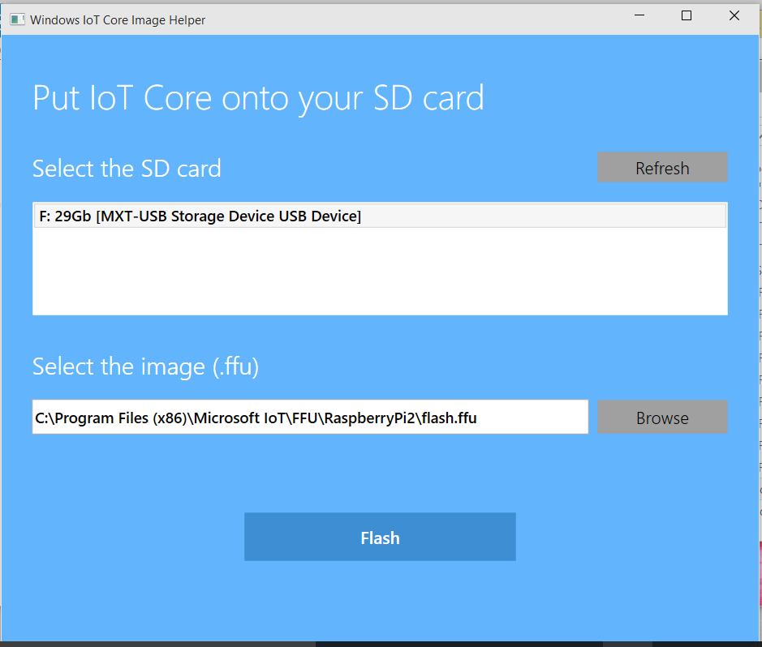

Slide 14
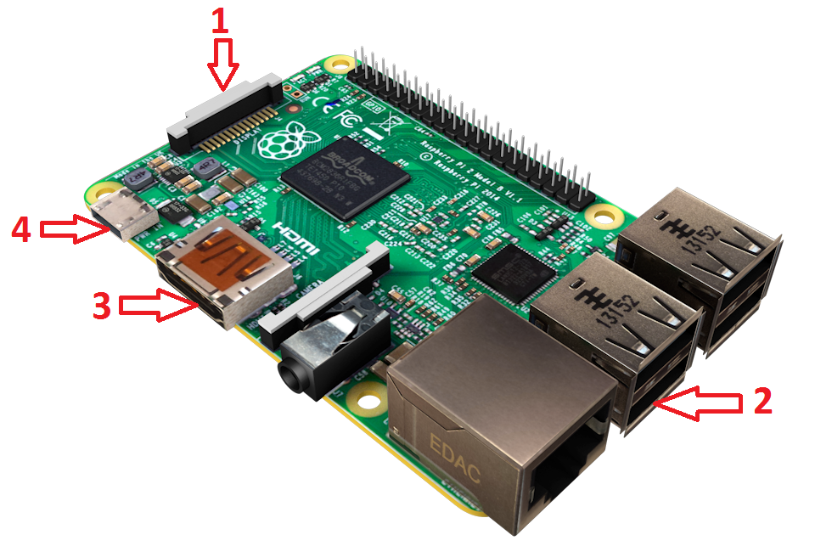
hook up the board

Slide 15
If everything goes right…..

Slide 16
The Bad News :(
Ethernet and RASPBERRY PI USB WIFI DONGLE is supported.
Lots of Universal APIs are not functional

Slide 17
The Good News!
Tons of stuff works!

Slide 18
So how do we talk to this thing?
http://<ip address>:8080
PowerShell <- in admin mode
ssh <- almost any flavor
ftp

Slide 19
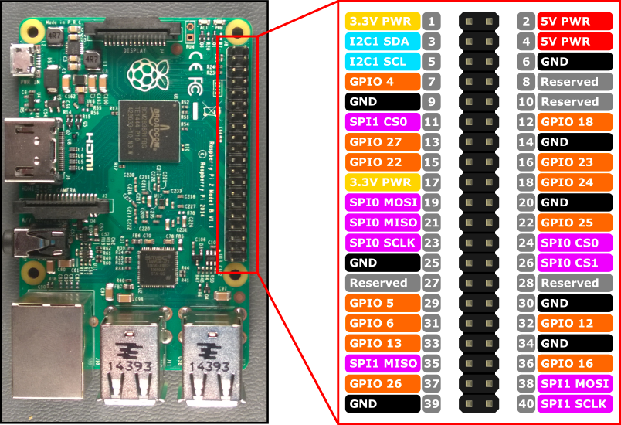
What is this GPIO thing?

Slide 20
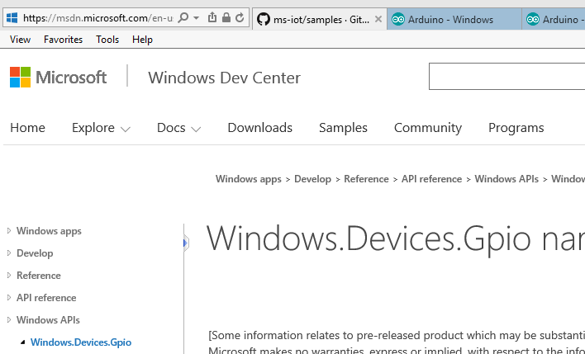
The API

Slide 21
Stop! PotPushBlinky time…

Slide 22
What the @#$%^!

Slide 23
What you are gonna need
Arduino UNO R3
SparkFun BlueSMiRF Gold
Arduino Development Environment
Breadboard and associated electronic bits
Lumia 520, Lumia 635, Lumina 640… <- huh?

Slide 24
Virtual Shield?
Accelerometer
Compass
Geolocator (GPS)
Gyrometer
Light Sensor
Orientation
Camera
Speech to Text and Speech Recognition
can receive table data from previous web search
Device info (name, date/time/timezone, os)
Email (initiation)
Microphone
Notifications (Tile/Toast)
Screen (Text, Images, Audio/Video, Rectangles, Buttons, Touchscreen)
Sms (initiation)
Web (Get and Post with result parsing)
Vibration

Slide 25
Stop! Arduino Time…

Slide 26
Links
That wifi dongle link: https://www.raspberrypi.org/products/usb-wifi-dongle/
https://dev.windows.com/en-us/iot
https://insider.windows.com/
https://ms-iot.github.io/content/en-US/win10/SetupRPI.htm
https://ms-iot.github.io/content/en-US/win10/samples/PowerShell.htm
https://www.hackster.io/

Slide 27
https://msdn.microsoft.com/en-us/library/windows/apps/xaml/windows.devices.gpio.aspx?f=255&MSPPError=-2147217396
http://www.arduino.cc/
https://www.sparkfun.com/products/12582
http://ms-iot.github.io/content/en-US/win10/SetupWVSA.htm
https://github.com/ms-iot/virtual-shields-arduino/

Slide 28
Thank You!
harold.pulcher@ImprovingEnterprises.com
214.613.4834
Upcoming Houston Classes:
PMP exam prep course, September 21-24.
Professional Scrum Master (PSM), September 22-23.
Professional Scrum Product Owner (PSPO), October 14-15.
Agile Scrum Immersion, October 22-23.
Professional Scrum Master (PSM), November 10-11
Join us for Monday Night Football!
November 16, 2015
Studio Movie Grill
City Centre
improvinghoustonmnf2015.eventbrite.com
Please include that I invited you!
Come work for us!
Contact Valerie.Carmona@improvingenterprises.com

Slide 29
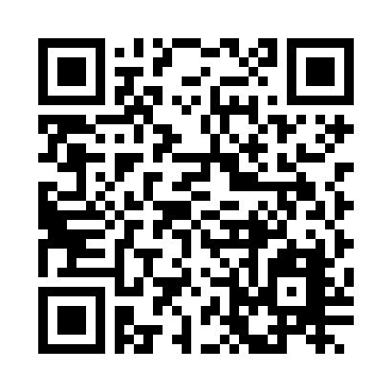
Please Leave Feedback During Q&A
If you leave session feedback and provide contact information in the survey, you will be qualified for a prize
Scan the QR Code to the right or go to http://bit.ly/1K1Hvi5

Slide 30
Thanks to all our Sponsors!

